Slide 1
Programming for problem solving
Presented by,
Devipriya M
Assistant professor
SRM IST Trichy

Slide 2
Tuple
Tuples are used to store multiple items in a single variable.
A tuple is a collection which is ordered and unchangeable.
Tuple items are ordered, unchangeable, and allow duplicate values.
thistuple = ("apple", "banana", "cherry") print(thistuple)
Output:
('apple', 'banana', 'cherry')

Slide 3
#tuple1 is the tuple of integers
>>> tuple1 = (1,2,3,4,5)
>>> tuple1
(1, 2, 3, 4, 5)
#tuple2 is the tuple of mixed data types
>>> tuple2 =('Economics',87,'Accountancy',89.6)
>>> tuple2
('Economics', 87, 'Accountancy', 89.6)
#tuple3 is the tuple with list as an element
>>> tuple3 = (10,20,30,[40,50])
>>> tuple3
(10, 20, 30, [40, 50])

Slide 4
#tuple4 is the tuple with tuple as an element
>>> tuple4 = (1,2,3,4,5,(10,20))
>>> tuple4
(1, 2, 3, 4, 5, (10, 20))
#incorrect way of assigning single element to
#tuple
#tuple5 is assigned a single element
>>> tuple5 = (20)
>>> tuple5
20
>>>type(tuple5) #tuple5 is not of type tuple
<class 'int'> #it is treated as integer

Slide 5
#Correct Way of assigning single element to #tuple
#tuple5 is assigned a single element
>>> tuple5 = (20,) #element followed by comma
>>> tuple5
(20,)
>>>type(tuple5) #tuple5 is of type tuple
<class 'tuple'>
#a sequence without parentheses is treated as #tuple by default
>>> seq = 1,2,3 #comma separated elements
>>> type(seq) #treated as tuple
<class 'tuple'>
>>> print(seq) #seq is a tuple
(1, 2, 3)

Slide 6
Accessing elements in a tuple
Elements of a tuple can be accessed in the same way as
a list or string using indexing and slicing.
>>> tuple1 = (2,4,6,8,10,12)
#initializes a tuple tuple1
#returns the first element of tuple1
>>> tuple1[0]
2
#returns fourth element of tuple1
>>> tuple1[3]
8

Slide 7
#returns error as index is out of range
>>> tuple1[15]
IndexError: tuple index out of range
#an expression resulting in an integer index
>>> tuple1[1+4]
12
#returns first element from right
>>> tuple1[-1]
12

Slide 8
Tuple is Immutable
Tuple is an immutable data type. It means that the elements of a tuple cannot be changed after it has been created.
An attempt to do this would lead to an error.
>>> tuple1 = (1,2,3,4,5)
>>> tuple1[4] = 10
TypeError: 'tuple' object does not support item assignment
However an element of a tuple may be of mutable type.

Slide 9
#4th element of the tuple2 is a list
>>> tuple2 = (1,2,3,[8,9])
#modify the list element of the tuple tuple2
>>> tuple2[3][1] = 10
#modification is reflected in tuple2
>>> tuple2
(1, 2, 3, [8, 10])

Slide 10
Tuple operations- Concatenation
>>> tuple1 = (1,3,5,7,9)
>>> tuple2 = (2,4,6,8,10)
>>> tuple1 + tuple2
#concatenates two tuples
(1, 3, 5, 7, 9, 2, 4, 6, 8, 10)
>>> tuple3 = ('Red','Green','Blue')
>>> tuple4 = ('Cyan', 'Magenta', 'Yellow'
,'Black')
#tuple5 stores elements of tuple3 and tuple4
>>> tuple5 = tuple3 + tuple4
>>> tuple5
('Red','Green','Blue','Cyan','Magenta',
'Yellow','Black')

Slide 11
Concatenation operator can also be used for extending an existing tuple.
>>> tuple6 = (1,2,3,4,5)
#single element is appended to tuple6
>>> tuple6 = tuple6 + (6,)
>>> tuple6
(1, 2, 3, 4, 5, 6)
#more than one elements are appended
>>> tuple6 = tuple6 + (7,8,9)
>>> tuple6
(1, 2, 3, 4, 5, 6, 7, 8, 9)

Slide 12
Repetition
>>> tuple1 * 3
('Hello', 'World', 'Hello', 'World', 'Hello',
'World')
#tuple with single element
>>> tuple2 = ("Hello",)
>>> tuple2 * 4
('Hello', 'Hello', 'Hello', 'Hello')

Slide 13
Membership
>>> tuple1 = ('Red','Green','Blue')
>>> 'Green' in tuple1
True
>>> tuple1 = ('Red','Green','Blue')
>>> 'Green' not in tuple1
False

Slide 14
Slicing
#tuple1 is a tuple
>>> tuple1 = (10,20,30,40,50,60,70,80)
#elements from index 2 to index 6
>>> tuple1[2:7]
(30, 40, 50, 60, 70)
#all elements of tuple are printed
>>> tuple1[0:len(tuple1)]
(10, 20, 30, 40, 50, 60, 70, 80)

Slide 15
#slice starts from zero index
>>> tuple1[:5]
(10, 20, 30, 40, 50)
#slice is till end of the tuple
>>> tuple1[2:]
(30, 40, 50, 60, 70, 80)
#step size 2
>>> tuple1[0:len(tuple1):2]
(10, 30, 50, 70)
#negative indexing
>>> tuple1[-6:-4]
(30, 40)
#tuple is traversed in reverse order
>>> tuple1[::-1]
(80, 70, 60, 50, 40, 30, 20, 10)

Slide 16
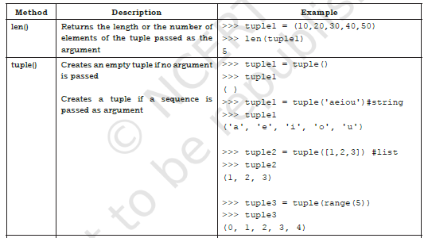
Methods for tuples

Slide 17
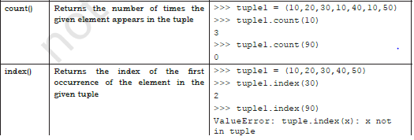

Slide 18
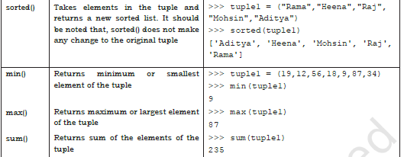

Slide 19
TUPLE ASSIGNMENT
Assignment of tuple is a useful feature in Python.
It allows a tuple of variables on the left side of the assignment operator to be assigned respective values from a tuple on the right side.
The number of variables on the left should be same as the number of elements in the tuple.

Slide 20
#The first element 10 is assigned to num1 and #the second element 20 is assigned to num2.
>>> (num1,num2) = (10,20)
>>> print(num1)
10
>>> print(num2)
20
>>> record = ( "Pooja",40,"CS")
>>> (name,rollNo,subject) = record
>>> name
'Pooja'
>>> rollNo
40
>>> (a,b,c,d) = (5,6,8)
ValueError: not enough values to unpack
(expected 4, got 3)

Slide 21
If there is an expression on the right side then first that expression is evaluated and finally the result is assigned to the tuple.
#15 is assigned to num3 and
#25 is assigned to num4
>>> (num3,num4) = (10+5,20+5)
>>> print(num3)
15
>>> print(num4)
25

Slide 22
Nested Tuple
#To store records of students in tuple and print them
st=((101,"Aman",98),(102,"Geet",95),(103,"Sahil",87),(104,"Pawan",79))
print("S_No"," Roll_No"," Name"," Marks")
for i in range(0,len(st)):
print((i+1),'\t',st[i][0],'\t',st[i][1],'\t',st[i][2])
Output:
S_No Roll_No Name Marks
1 101 Aman 98
2 102 Geet 95
3 103 Sahil 87
4 104 Pawan 79

Slide 23
Dictionaries
The data type dictionary fall under mapping.
It is a mapping between a set of keys and a set of values.
The key-value pair is called an item.
A key is separated from its value by a colon(:) and consecutive items are separated by commas.
Items in dictionaries are unordered, so we may not get back the data in the same order in which we had entered the data initially in the dictionary.
The keys in the dictionary must be unique and should be of any immutable data type, i.e., number, string or tuple.
The values can be repeated and can be of any data type.

Slide 24
Creating a dictionary
#dict1 is an empty Dictionary created
#curly braces are used for dictionary
>>> dict1 = {}
>>> dict1
{}
#dict2 is an empty dictionary created using
#built-in function
>>> dict2 = dict()
>>> dict2
{}

Slide 25
#dict3 is the dictionary that maps names of the students to respective marks in percentage
>>> dict3 = {'Mohan':95,'Ram':89,'Suhel':92,
'Sangeeta':85}
>>> dict3
{'Mohan': 95, 'Ram': 89, 'Suhel': 92,
'Sangeeta': 85}

Slide 26
Accessing Items in a dictionary
The items of a dictionary are accessed via the keys rather than via their relative positions or indices.
>>> dict3 = {'Mohan':95,'Ram':89,'Suhel':92,
'Sangeeta':85}
>>> dict3['Ram']
89
>>> dict3['Sangeeta']
85
#the key does not exist
>>> dict3['Shyam']
KeyError: 'Shyam'

Slide 27
Dictionaries are Mutable
Adding a new item
>>> dict1 = {'Mohan':95,'Ram':89,'Suhel':92,'Sangeeta':85}
>>> dict1['Meena'] = 78
>>> dict1
{'Mohan': 95, 'Ram': 89, 'Suhel': 92,
'Sangeeta': 85, 'Meena': 78}

Slide 28
Modifying an Existing Item
>>> dict1 = {'Mohan':95,'Ram':89,'Suhel':92,
'Sangeeta':85}
#Marks of Suhel changed to 93.5
>>> dict1['Suhel'] = 93.5
>>> dict1
{'Mohan': 95, 'Ram': 89, 'Suhel': 93.5,
'Sangeeta': 85}

Slide 29
Membership
>>> dict1 = {'Mohan':95,'Ram':89,'Suhel':92,
'Sangeeta':85}
>>> 'Suhel' in dict1
True
>>> dict1 = {'Mohan':95,'Ram':89,'Suhel':92,
'Sangeeta':85}
>>> 'Suhel' not in dict1
False

Slide 30
TRAVERSING A DICTIONARY
>>> dict1 = {'Mohan':95,'Ram':89,'Suhel':92,
'Sangeeta':85}
Method 1
>>> for key in dict1:
print(key,':',dict1[key])
Output:
Mohan: 95
Ram: 89
Suhel: 92
Sangeeta: 85

Slide 31
Method 2
>>> for key,value in dict1.items():
print(key,':',value)
Output:
Mohan: 95
Ram: 89
Suhel: 92
Sangeeta: 85

Slide 32
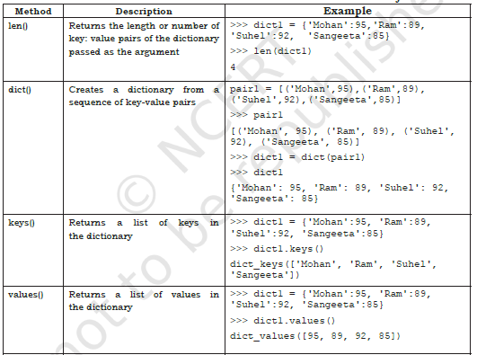

Slide 33

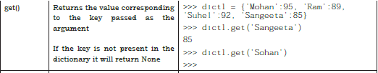

Slide 34
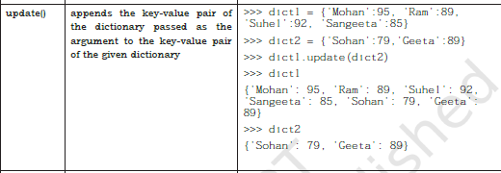

Slide 35
